Slide 1


Social Buzz

Slide 2


Today's agenda
Project recap
Problem
The Analytics team
Process
Insights
Summary

Slide 3

This project intends to provide Social Buzz with helpful insights regarding their rapidly growing business. Insights include but are not limited to: The most popular categories on the platform and the associated reactions.
Project Recap

Slide 4

Problem
Social Buzz is growing faster than they can handle so they need a third party to garner useful insights from their platform data. They wish to know their most popular content based on their complex algorithm

Slide 5



Diego Benavides:
Data Analyst
Michelle Grove:
Data Scientist
The Analytics team
Andrew Fleming:
Chief Technical Architect
Marcus Rompton:
Senior Principle

Slide 6
Process
1
Acquire Data
2
Clean and Reformat Data
3
Analyze the Data
4
Visualize and Model Data
5
Report Insights to Social Buzz

Slide 7
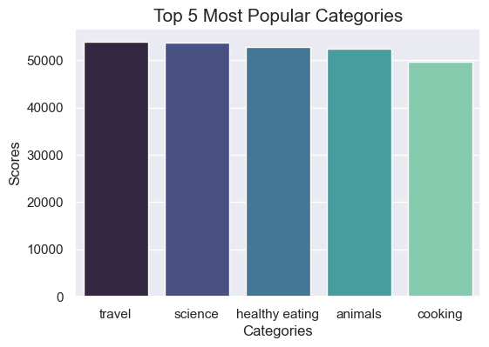
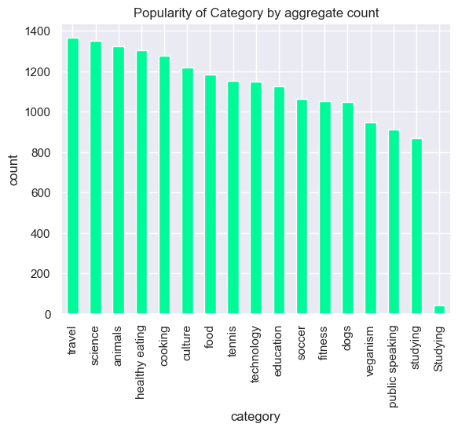

Insights
The following insights are focused on the top five popular categories on social buzz and how positively or negatively each category is rated by users of Social Buzz. The insights also include analysis of the content types and how they are received by the Social Buzz users.

Slide 8
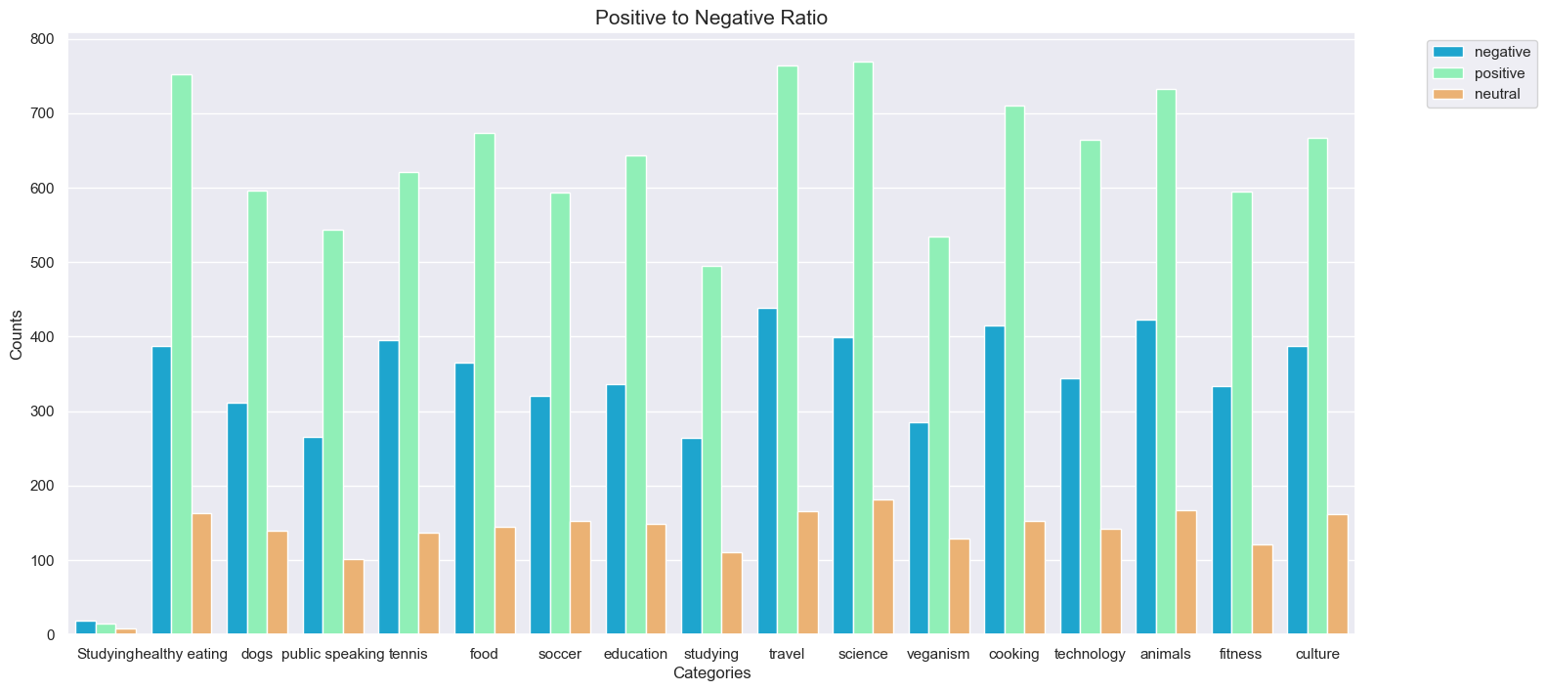
The top five most popular categories shown in the last slide demonstrates that the most popular categories are negligibly similar in popularity. The plot above demonstrates that all the categories on Social Buzz are mostly received positively rather than negatively or neutrally.

Slide 9
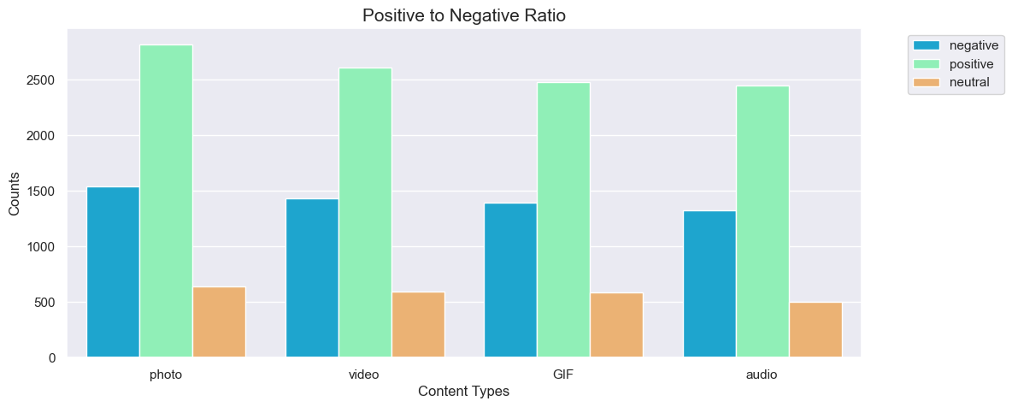
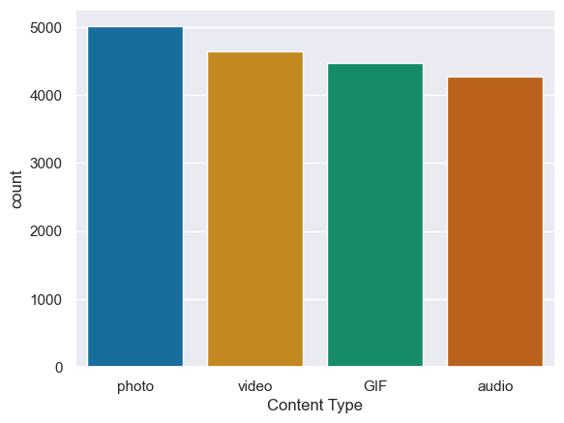
The Social Buzz platform is slightly dominated by photos, but as expected all content types are received overwhelmingly positively.

Slide 10
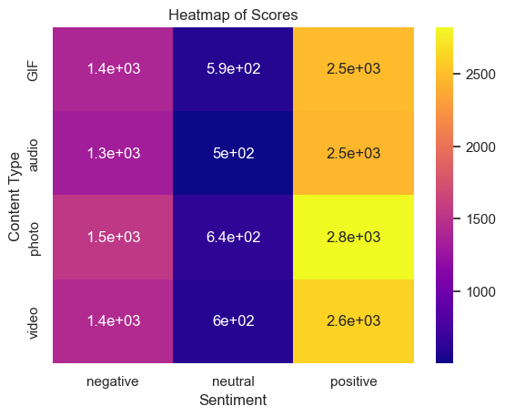
The heat map is a heat map of the scores varying
as a function of content type and sentiment.
No content type is significantly more likely to be rated as
Positive, negative, or neutral. Comparatively all content types
will be mostly positive, then negative, and then neutral.

Slide 11

The most important insight from this data is that Social Buzz should focus on optimizing its algorithm on travel, science, healthy eating, animals, and cooking. The platform seems to be a positive environment with people who have a diverse set of opinions.
Summary

Slide 12
Thank you!
ANY QUESTIONS?

